Slide 1
Skill Development Course cs 227 Core Java
Lecture 1
Ashwini S. Mane

Slide 2
Agenda
Syllabus
Examination Scheme
Course Objectives
Course Outcomes
History of Java
Parts of Java
Difference between Java and others
Features of Java

Slide 3
Syllabus
Fundamentals of java
Object and class
Java Collections
Interfaces
Abstract class and inheritance
Exception handling
File Handling
Packages
Graphical user interfaces using swing
Database management

Slide 4
Examination scheme
End Semester Exam (ESE) 50 MARKS
Internal Assessment (IA) 25 MARKS
TOTAL 75 MARKS

Slide 5
COURSE OBJECTIVES
1: To design and program stand-alone Java
applications.
2: To extend Java classes with inheritance
and dynamic binding.
3: To use exception handling and file
handling in Java applications.
4: To design a graphical user interface
(GUI) with Java Swing.
5: To implement database applications.

Slide 6
COURSE OUTCOMES
Students successfully completing the course will be able to
1: Implement Object Oriented
Programming Concepts in java.
2: Use and create packages and
interfaces in Java.
3: Use graphical user interface in Java
programs.
4: Perform file handling operations.
5: Implement exception handling in Java.
6: Implement applications using JDBC .

Slide 7
History of java
In 1996, 23rd January first version of Java was introduced in the market but preparation of Java was started in 1991, when SUN Microsystem was in need of software for simple electronics consumer devices such as cable TV switch boxes and remote controllers, they were in need of good programming language
Formed team of 30 members lead by James Gousling , named it as Green Project and they focus on 3 qualities
1. Simple Programming Language
2. Tight Coded Programming Language
3. Architecture neutral programming language

Slide 8
Simple Programming Language:
a. Less Execution Time: More
performance (Remote Control
operation)
b. Less Memory consumption : Less
product cost (Buying Laptop)
c. Less Power Consumption: Less
Maintenance cost (Remote Batteries)
Tight Coded Programming Language:
In C, stack operations need more LOC
In java, less LOC for more complicated
requirement
Stack s = new Stack()
s.push(1);
s.pop()
Architectural Neutral Language: Has to execute all its functionalities in all the h/w architecture

Slide 9
In 1991, PASCAL WAS VERY POPULAR (Niclause Wirth)
It was POPL
So SUN microsystem decided to implement object oriented PL
In December, 1992 James Gousling and his green team came up with new OOPL and named it OAK
But due to existing registration of name OAK renamed it JAVA (name of coffee)
In 1993, SUN developed its first product *7 (Remote Control) using Java
But there was no market for *7. It became failure product

Slide 10
In mid 1994, www was in market
Musaik browser developed by Mark Anderson (UG student)
In 1994 -95 ,SUN designed one browser named Hot Java Browser using Applet
In Jan 23rd, 1996, JDK 1.0 launched in the market

Slide 11
Versions of java
JDK 1.0 (January 23, 1996)
JDK 1.1 (February 19, 1997)
J2SE 1.2 (December 8, 1998)
J2SE 1.3 (May 8, 2000)
J2SE 1.4 (February 6, 2002)
J2SE 5.0 (September 30, 2004)
Java SE 6 (December 11, 2006)
Java SE 7 (July 28, 2011)
Java SE 8 (March 18, 2014)
Java SE 9 (September 21, 2017)
Java SE 10 (March 20, 2018)
Java SE 11 (September 25, 2018)
Java SE 12 (March 19, 2019)
Java SE 13 (September 17, 2019)
Java SE 14 (March 17, 2020)
Java SE 15 (September 15, 2020)
Java SE 16 (Expected in March,2021)

Slide 12
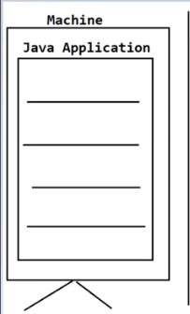
PARTS OF JAVA
1.J2SE/JAVASE java 2 standard edition covers fundamentals of JAVA programming language enable to develop standalone application (without Client Server , Distributed architecture)
e.g. Calculator , Bill generator
Only 5% applications are standalone applications but dependency of java is 1000% (eg. Selenium, Hadoop, Salesforce,SAP)

Slide 13
2.J2EE/ JAVA EE
JAVA 2 Enterprise edition used for creating server side programming.
Enterprise application/Distributed application (with client server and distributed architecture)
95% applications are enterprise applications
eg. Banking, Insuarance , Aerospace, e-commerce, online sales
3. J2ME/ JAVA ME
Java 2 Micro edition
Micro Programming
Mobile based application
Eg. MyAirtel, Myjio app, Mobile gaming

Slide 14
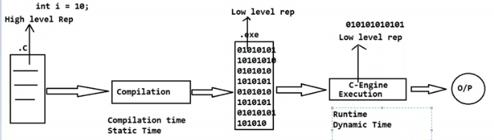
Difference between java and others(c,c++)
C and C++ are static programming languages, but Java is a dynamic programming language
C – engine (binary/Machine code), C++ -engine, JVM
C and C++ allows memory allocation for primitive data types at compile time
Java allows memory allocation for primitive data types at runtime

Slide 15
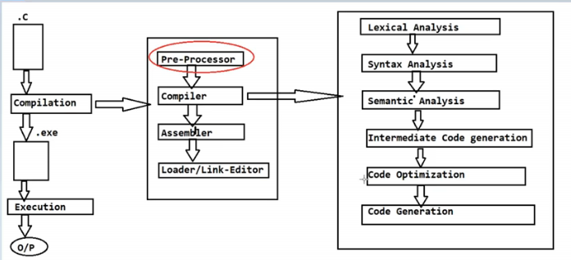
2. Preprocessor is required in C and C++ (# include, #define) but not in java
Preprocessors in C,C++ performs static loading of header files into memory at compile time
Pre-processor is not needed in Java as complete predefined library is provided with classes and interfaces in packages
import java.io.*;
Import java.util.*;
Import java.util.Scanner;
In java packages will not get loaded into memory
by compile time but JVM loads it at runtime

Slide 16
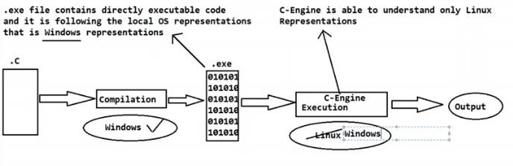
3. C and C++ are platform dependent (compilation and execution on same OS) and java is platform independent

Slide 17
Features of java
Simple
Object-Oriented
Portable
Platform independent
Secured
Robust
Architecture neutral
Interpreted
High Performance
Multithreaded
Distributed
Dynamic

